Slide 1



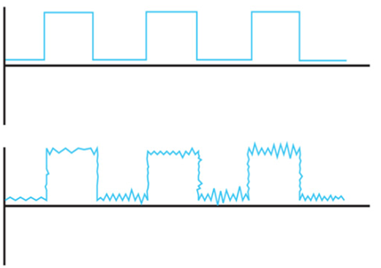












Errors in data communication

Slide 2






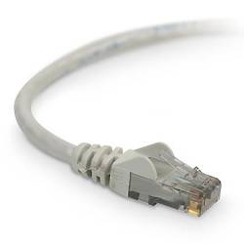



Errors in data communication
Extremely rare within a computer’s circuits, but quite frequent outside
Caused by electrical interference
  (Large electric motors being switched on/off, microwave interfering with the wifi etc.)
Notes:
It can take decades of a modern PC’s continuous operation to have one accidental error. 10^-18

Slide 3



Types of errors
Sent
Received
Single-bit error
Usually caused by white noise
Notes:
In digital transmission systems, an error occurs when a bit is altered between transmission and reception; that is, a binary 1 is transmitted and a binary 0 is received, or a binary 0 is transmitted and a binary 1 is received. Two general types of errors can occur: single-bit errors and burst errors.
A single-bit error is an isolated error condition that alters one bit but does not affect nearby bits. A single-bit error can occur in the presence of white noise, when a slight random deterioration of the signal-to-noise ratio is sufficient to confuse the receiver's decision of a single bit.
A burst error of length B is a contiguous sequence of B bits in which the first and last bits and any number of intermediate bits are received in error. Burst errors are more common and more difficult to deal with. Burst errors can be caused by impulse noise, and by fading in a mobile wireless environment. Note that the effects of burst errors are greater at higher data rates.

Slide 4




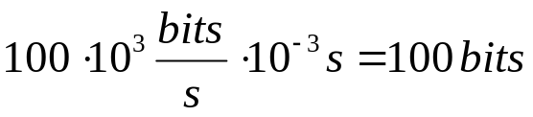
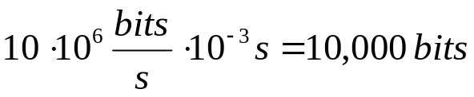
Types of errors
Sent
Received
Burst error
Usually caused by impulse noise
Example: An impulse noise event lasts for 1 ms.
At 100 Kbps, the burst error is:
At 10 Mbps, the burst error is:
Notes:
In digital transmission systems, an error occurs when a bit is altered between transmission and reception; that is, a binary 1 is transmitted and a binary 0 is received, or a binary 0 is transmitted and a binary 1 is received. Two general types of errors can occur: single-bit errors and burst errors.
A single-bit error is an isolated error condition that alters one bit but does not affect nearby bits. A single-bit error can occur in the presence of white noise, when a slight random deterioration of the signal-to-noise ratio is sufficient to confuse the receiver's decision of a single bit.
A burst error of length B is a contiguous sequence of B bits in which the first and last bits and any number of intermediate bits are received in error. Burst errors are more common and more difficult to deal with. Burst errors can be caused by impulse noise, and by fading in a mobile wireless environment. Note that the effects of burst errors are greater at higher data rates.

Slide 5
Error Prevention
Some prevention actions can be taken
Improve cable’s shielding
Replace older equipment
Reduce the transmission speed
For wireless: Stay away from devices sharing the same wireless frequencies
…
But errors will still occur.
Notes:
Cable shielding is usually braided strands of metal (copper, aluminium etc), covered with a jacket. The shield acts as a Faraday Cage to reduce electrical noise and electromagnetic radiation from interfering with other devices.

Slide 6
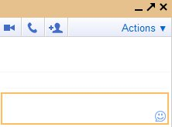
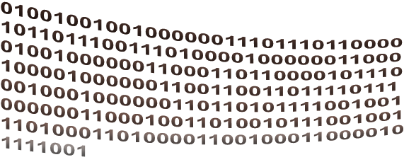
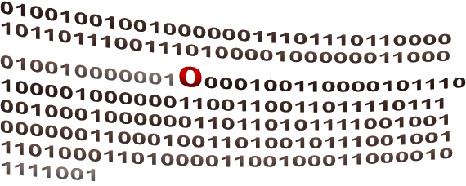
Errors in data communication
Maria
Lin
Maria: I want a bat for my birthday
I want a cat for my birthday
A bat?!!
In binary
This never happens, of course, thanks to Error Detection and Error Control

Slide 7
ERROR DETECTION

Slide 8
Error Detection
Error-detecting code (check bits) added by the transmitter and checked by the receiver
Common methods:
Simple Parity (also known as Vertical Redundancy Check)
Longitudinal Redundancy Check (LRC, also known as Horizontal Parity)
Cyclic Redundancy Check (CRC)
Notes:
Regardless of the design of the transmission system, there will be errors, resulting in the change of one or more bits in a transmitted frame. Error detection is performed by calculating an error-detecting code that is a function of the bits being transmitted. The code is appended to the transmitted bits. The receiver calculates the code based on the incoming bits and compares it to the incoming code to check for errors. A detected error occurs if and only if there is a mismatch. There is a probability that a frame contains errors and that the error-detecting scheme will detect that fact. Also have a residual error rate, being the probability that an error will be undetected despite the use of an error-detecting scheme.
CRC is the most elaborate among the ones in wide use today.

Slide 9



Error Detection: Simple Parity Check
the simplest error detecting scheme is to add 1 bit to the end of a block of data to create odd (or even) parity
ODD PARITY: odd number of 1s
add
To ensure odd number of 1s
or
EVEN PARITY: even number of 1s
add
To ensure even number of 1s
Notes:
The simplest and easiest to implement error-detecting scheme is to append a parity bit to the end of a block of data. The value of this bit is selected so that the character has an even number of 1s (even parity) or an odd number of 1s (odd parity).
Note, however, that if two (or any even number) of bits are inverted due to error, an undetected error occurs. Typically, even parity is used for synchronous transmission and odd parity for asynchronous transmission. The use of the parity bit is not foolproof, as noise impulses are often long enough to destroy more than one bit, particularly at high data rates.

Slide 10



Error Detection: Simple Parity Check
ODD PARITY

Slide 11


Error Detection: Simple Parity Check
ODD PARITY

Slide 12






Error Detection: Simple Parity Check
If an odd number of errors occur, the recipient sees even number of 1s and knows that there must be an error.
Sent odd number of 1s
Received even number of 1s
But if an even number of errors occur, then there are still odd number of 1s and so odd parity fails to detect them:
Sent odd number of 1s
Received odd number of 1s
Notes:
Odd parity checking detects only odd number of errors. So, success rate is something around 50% and message is ~15% longer

Slide 13
Error Detection: LRC
Longitudinal Redundancy Check (or Horizontal Parity)
Group together codes in blocks
Add a parity bit for each row
Add a parity bit for each column
If any of the individual parity checks is violated, the error is detected
Notes:
A bit better than simple parity, in the sense that it can detect even errors too.

Slide 14








Error Detection: LRC
Group together codes in blocks
Add an even parity bit for each row
Add an even parity bit for each column
Block Check Character

Slide 15
Error Detection: LRC
Original message we wanted to send
After including the LRC parity bits, the message is now much longer:

Slide 16












Error Detection: LRC
Example of successful detection:
Although parity of all rows is even (and simple parity would have missed the errors), the parity of two of the columns is now odd.
Sent
Received

Slide 17

Error Detection: LRC
Example of failure to detect the errors:
Despite four errors, parity is still even across all rows and columns.
Sent
Received
Notes:
LRC success rate is about 80%, but message is now 40% longer.

Slide 18


Error Detection: CRC
Cyclic Redundancy Check:
For block of k bits generate an n bit frame check sequence (FCS)
Transmit k+n bits which is exactly divisible by some predetermined number
Receiver divides frame by that number
If remainder is not 0, there is an error
k bits of data (e.g. 1,000 bits)
n bits FCS (usually 8 - 32 bits)
Notes:
One of the most common, and one of the most powerful, error-detecting codes is the cyclic redundancy check (CRC), which can be described as follows. Given a k-bit block of bits, or message, the transmitter generates an (n – k)-bit sequence, known as a frame check sequence (FCS), such that the resulting frame, consisting of n bits, is exactly divisible by some predetermined number. The receiver then divides the incoming frame by that number and, if there is no remainder, assumes there was no error. Can state this procedure in three equivalent ways: modulo 2 arithmetic, polynomials, and digital logic, as detailed in Stallings DCC9e chapter 6.3. Comes down to working out what remainder exists when divide data by desired number, and using that as the FCS value appended to the data to form the block.
Almost 100% success rate.

Slide 19

Error Detection: CRC
An Example
data
Treat the data as a large polynomial
1·x⁸+0·x⁷+1·x⁶+0·x⁵+0·x⁴+1·x³+1·x²+0·x¹+1·x⁰
Divide by given generating polynomial
e.g. by x¹⁶+x¹⁵+x²+1 (CRC-16)
Append the remainder of the division to the end of the original data and then send
The recipient divides the incoming data by the same generating polynomial. If there is a remainder, then there is an error

Slide 20
Error Detection: CRC
Examples of standard generating polynomials:
x¹²+x¹¹+x³+x²+x+1 (CRC-12)
x¹⁶+x¹⁵+x²+1 (CRC-16)
x¹⁶+x¹⁵+x⁵+1 (CRC-CCITT)
x³²+x²⁶+x²³+x²²+x¹⁶+x¹²+x¹¹+x¹⁰+x⁸+x⁷+x⁵+x⁴+x²+x+1 (CRC-32)

Slide 21
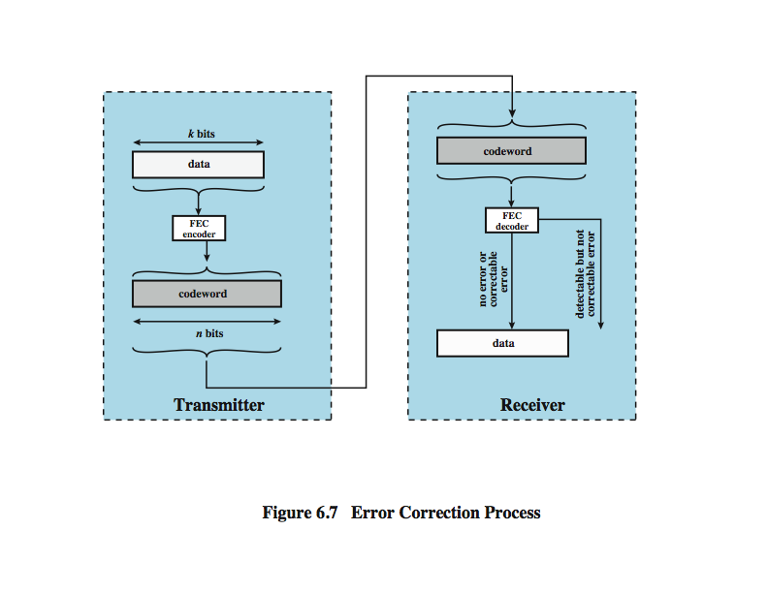

Error Detection Process
William Stallings, “Data and Computer Communications”
Notes:
For a given frame of bits, additional bits that constitute an error-detecting code are added by the transmitter. This code is calculated as a function of the other transmitted bits. Typically, for a data block of k bits, the error-detecting algorithm yields an error-detecting code of n – k bits, where (n – k) < k. The error-detecting code, also referred to as the check bits, is appended to the data block to produce a frame of n bits, which is then transmitted. The receiver separates the incoming frame into the k bits of data and (n – k) bits of the error-detecting code. The receiver performs the same error-detecting calculation on the data bits and compares this value with the value of the incoming error-detecting code. A detected error occurs if and only if there is a mismatch.

Slide 22
Forward Error Correction Process
William Stallings, “Data and Computer Communications”
Notes:
Stallings DCC9e figure 6.7 shows in general how this is done. On the transmission end, each k-bit block of data is mapped into an n-bit block (n > k) called a codeword, using an FEC (forward error correction) encoder. The codeword is then transmitted. During transmission, the signal is subject to impairments, which may produce bit errors in the signal. At the receiver, the incoming signal is demodulated to produce a bit string that is similar to the original codeword but may contain errors. This block is passed through an FEC decoder, with one of four possible outcomes:
1. If there are no bit errors, the input to the FEC decoder is identical to the original codeword, and the decoder produces the original data block as output.
2. For certain error patterns, it is possible for the decoder to detect and correct those errors, the FEC decoder is able to map this block into the original data block.
3. For certain error patterns, the decoder can detect but not correct the errors, the decoder simply reports an uncorrectable error.
For certain, typically rare, error patterns, the decoder does not detect that any errors have occurred and maps the incoming data block into a block different from the original.

Slide 23









Hamming Code
A code, where special bits have been added to the data bits, so that in case of error the receiver may be able to correct it
Example
Each hamming code check bit is checking different sequences of data bits (e.g. via even parity)

Slide 24







Hamming Distance between two codes
the number of positions at which two codes of equal length differ
The Hamming distance of
is
3
and
The Hamming distance of
is
2
and

Slide 25
Hamming Distance
Hamming Distance of a code is the minimum number of bits by which two characters of this code can differ
…
100 1010 | J
100 1011 | K
100 1100 | L
100 1101 | M
100 1110 | N
100 1111 | O
101 0000 | P
101 0001 | Q
101 0010 | R
101 0011 | S
In the ASCII character set, some characters differ by only one bit.
So, the hamming distance of the ASCII set is 1.
…
If Hamming Distance = 1, we can’t detect errors
If we add a parity bit, the minimum difference becomes 2.
With Hamming Distance = 2, we can detect errors, but not correct them too
To be able to correct errors, we need a greater Hamming Distance
Notes:
The Hamming Distance is a characteristic of the code.

Slide 26
Hamming Distance
Hamming Distance = D + C +1
Number of errors we can correct
Number of errors we can detect
e.g. if hamming distance = 3, we can detect one single bit error and correct that error, or we can detect two errors and correct none

Slide 27
Hamming Distance: Example
Hamming Distance
What is the hamming distance
of the following 5-bit code?
 | A | B | C | D
A
B
C
D
-
2
2
4
A | 10001
B | 11000
C | 10010
D | 01010
-
-
2
2
-
-
-
2
-
-
-
-
Hamming Distance = D + C +1
Since minimum hamming distance = 2, we can detect up to one single bit error (D = 1)
and correct C = 0 errors

